Slide 1


UPI Payment Analysis
Insights into UPI Transactions, Bank Stability, and Risk Hotspots

Slide 2
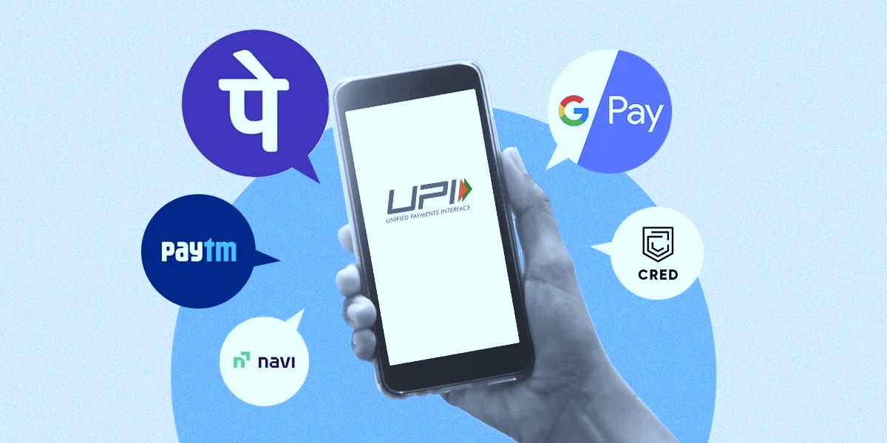
CONTEXT
India’s UPI platform has completely changed how people make payments, growing at a speed never seen before. But this rapid growth has also created practical challenges for banks, payment apps, and regulators.
UPI transaction data — such as volumes, success rates, failures, fraud count, and regional patterns — is scattered across different systems and reports. Because of this, stakeholders often struggle to understand what’s really happening in the UPI ecosystem.
Banks and Fintechs struggle to handle sudden spikes in transaction volume, rising failure numbers, and uneven performance across apps and states — but they can’t easily pinpoint where these issues are happening or which part of their system is getting stressed
Regulators and policymakers find it hard to spot which states are growing, which regions face more fraud, and which areas need better awareness or infrastructure. Payment apps also lack a simple way to compare their performance with competitors or understand shifting user behavior.
Without one unified, reliable view of all these metrics, problems are usually addressed only after they cause service disruptions, customer complaints, or security risks. This leads to slow decision-making, higher operational costs, and missed opportunities for improvement.

Slide 3
Identify transaction bottlenecks and failure-prone banks to improve system reliability. Understand regional and demographic adoption patterns to drive digital inclusion. Detect fraud hotspots and emerging risk trends to enhance user safety and trust Benchmark app and bank performance to optimize competition, partnerships, and customer experience.
OBJECTIVE

Slide 4
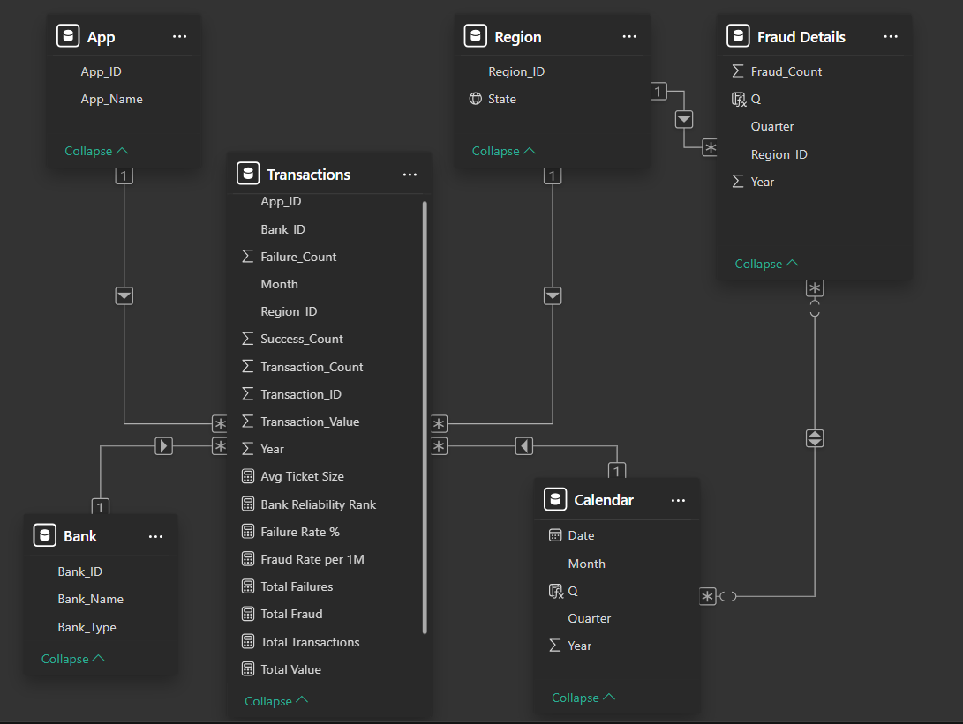
ABOUT DATA
The data model is primarily based on a Star Schema, with Transactions as the central fact table connected to key dimensions like App, Bank, Calendar, and Region to analyze transaction performance.
The Calendar dimension is linked to both Transactions and Fraud Details, enabling time-based analysis of both regular and fraudulent activities.
The Fraud Details table acts as a separate fact table containing measures like Fraud_Count etc and is connected only to Calendar and Region, not to Transactions.
This creates two independent Star Schemas sharing common dimensions, allowing fraud and transaction data to be analyzed independently while still using
shared context.

Slide 5

KPI
127M
34.62bn
272.52
Total Transactions
Total Value
Avg. Ticket Size
Represents the volume of UPI usage, showing how widely the system is adopted.
It’s driven by user awareness, app usability, and merchant acceptance.
To grow further, focus on expanding rural outreach, cashback programs, and smoother onboarding.
The total monetary value of all transactions processed.
High-value transactions, overall economic activity, and an increasing Average Ticket Size (ATS) drive this up
To boost it, enable higher transaction limits and promote business payments.
Indicates the average value per transaction, revealing user behavior patterns.
Low ATS means daily small payments (P2M), while a rise suggests larger peer-to-peer (P2P) or business transfers.
To improve, target high-value users, enable bill payments, and enhance trust for large transfers.

Slide 6

KPI
1.10%
619.78
Failure Rate %
Fraud Rate per 1M
Measures system reliability and transaction success.
Affected by bank server downtimes, network lags, or user mistakes.
High failure rates reduce trust and user satisfaction. To improve, enhance server capacity, error handling, and retry mechanisms.
Represents the rate of fraudulent transactions, reflecting the system’s security resilience.
It’s driven by phishing, unauthorized access, and low user awareness.
To reduce it, implement advanced fraud detection, AI-based monitoring, and awareness campaigns.

Slide 7
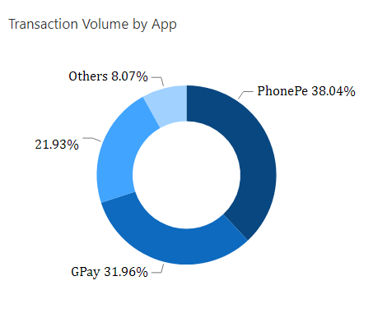
Market Dominance by App
The UPI app market is highly concentrated, with PhonePe (38.04%), GPay (31.96%), and Paytm (21.93%) together accounting for over 90% of total transactions, while other apps contribute only 8.07%
This shows strong user trust in these apps but also means very few players control most of the ecosystem.
If any one of these major apps faces downtime, a large share of India’s UPI payments could be disrupted for users and merchants.
To make system more reliable , regulators and banks should promote smaller UPI players, ensure multi-app interoperability, and strengthen backend infrastructure to reduce single-point failures.
Paytm

Slide 8
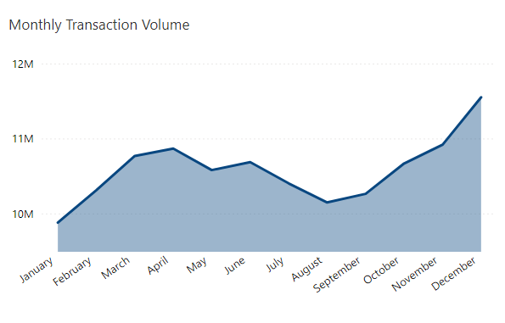
Transaction Growth Momentum
UPI transactions show a steady upward trend, increasing from 9.8M in Jan to 11.5M in Dec, with value rising from ₹266B to ₹313B.
Year-over-year growth is 21.37%, showing strong digital adoption across both 2023 and 2024.
There is a mid-year dip (May–Aug) due to seasonal slowdown, followed by a sharp rise from Sep–Dec driven by festivals, salary cycles, and higher merchant usage.
The overall trend shows growing user trust and expanding use cases.
As volumes rise, apps and banks need scalable infrastructure, faster processing, and better monitoring to maintain low failure rates.

Slide 9
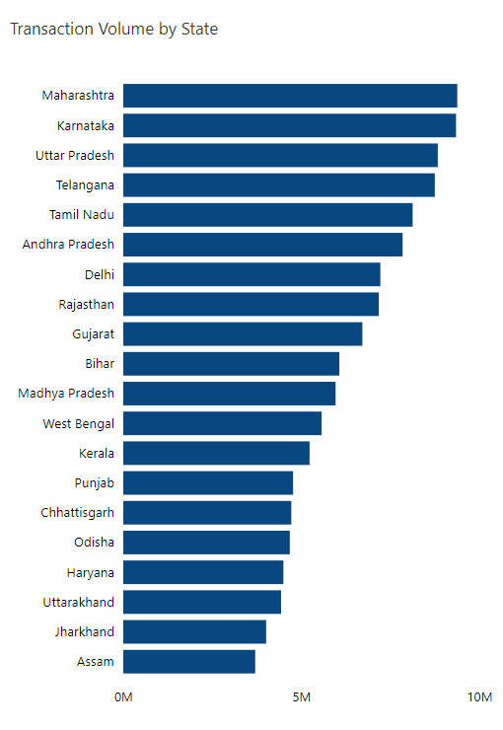
State-wise Adoption
Maharashtra leads with 9.38M transactions worth ₹260B, followed by Karnataka, Uttar Pradesh, Telangana, and Tamil Nadu.
Assam has the lowest usage (3.7M transactions, ₹100B), showing that smaller states are still adopting UPI.
Big states lead because they have more businesses, better internet, and higher digital payment adoption.
These top states contribute majorly to India’s UPI volume — so any technical issues in these regions can impact national performance
To boost smaller states, we need better connectivity, more merchant onboarding, and stronger awareness about safe UPI use.

Slide 10
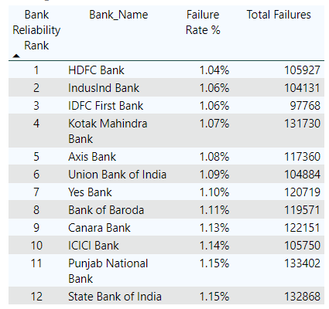
Bank Reliability
The ranking is based on failure rate (%), which shows how reliably each bank handles UPI transactions.
HDFC Bank is the most reliable with a 1.04% failure rate. Even though its failure count is high, it handles a very large number of transactions, so its performance is still strong.
IDFC First Bank has fewer failures overall, but its slightly higher failure rate (1.06%) places it below HDFC, showing it manages a smaller transaction volume.
SBI has the highest failure rate (1.15%) along with a high failure count, indicating performance issues during heavy load.
Banks with large transaction volumes need to keep improving their UPI systems to maintain low failure rates and ensure smooth customer experience.

Slide 11
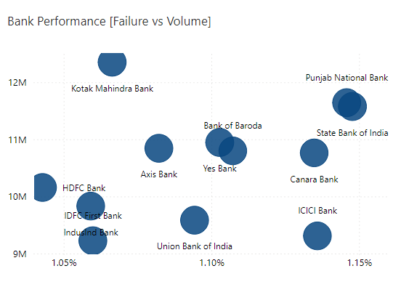
Bank Performance
The scatter plot compares banks’ failure rates with their transaction volumes.
SBI shows the highest failure rate (1.15%) even with high volume (~11.5M), indicating its systems struggle under heavy load.
PNB and ICICI also show higher failure rates, suggesting backend inefficiencies.
HDFC performs the best with the lowest failure rate (1.04%) while handling 10M+ transactions, proving strong reliability under pressure
Kotak manages a balanced performance with moderate failure rate (1.07%) at 12M+ volume, showing efficient load handling.
Overall, banks on the left side (low failure rate) handle high volumes well, while banks on the right side (higher failure rate) face stress even with moderate loads

Slide 12
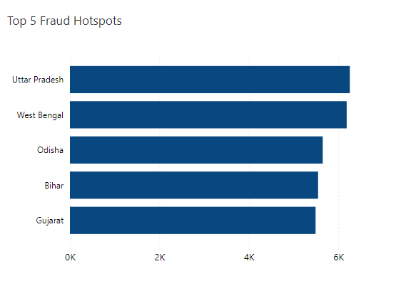
Fraud Hotspots
Uttar Pradesh is the top fraud hotspot with 6,255 cases and 708 per 1M transactions. West Bengal and Odisha follow closely, while Bihar ranks fifth with 5,546 cases and 913.87 per 1M transactions.
Fraudulent activity does not always correlate with transaction volume. Localized factors like lower financial literacy, weaker state-level anti-fraud enforcement likely drive higher fraud rates.
These states require targeted awareness campaigns and stricter fraud monitoring. High fraud rates can erode customer trust and may lead to stricter transaction limits or added friction in the payment process.

Slide 13
CONCLUSION
The analysis of the UPI Payment Dashboard reveals an ecosystem defined by explosive growth alongside critical operational challenges. The platform is clearly dominant, driven by major apps like PhonePe and GPay and concentrated in economic hubs like Maharashtra and Karnataka.
The key takeaway is a story of resilience under pressure: despite handling massive, surging transaction volumes (especially toward year-end), the system maintains an impressively low average failure rate of 1.10%. This demonstrates the robust infrastructure of leading banks like HDFC and Kotak . However, the presence of distinct Fraud Hotspots (West Bengal, Uttar Pradesh) and the structural risk posed by high market concentration remain persistent threats.
UPI has moved beyond adoption into its optimization and governance phase. Targeted interventions, continuous monitoring, and predictive analysis are crucial to secure growth, improve system reliability, and maintain customer trust.

Slide 14

THANK YOU!

